Slide 1
Analysis of FTSE100 and S&P500 Indices for 2020
Ariton Alexandru
Group 1139

Slide 2
Objectives
Compute and interpret daily returns for FTSE100.
Analyze descriptive statistics and test for normality using the Jarque-Bera Test.
Calculate Beta values and perform the Jensen Test for CAPM.
Evaluate autocorrelations with SACF and SPACF.
Conduct unit root and co-integration tests for FTSE100 and S&P500.
Model volatility using ARCH and GARCH models.

Slide 3
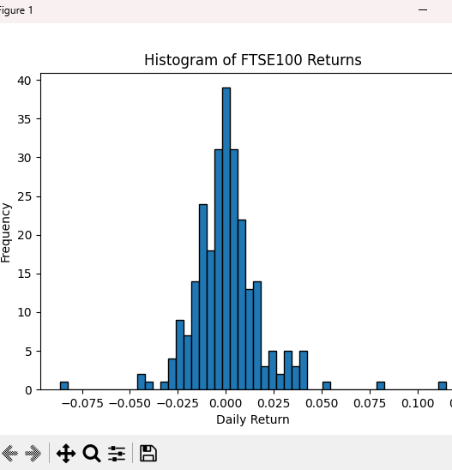
Daily Returns and Descriptive Statistics
Descriptive Statisitcs:
Mean: 0.000620 — Minimal directional bias.
Standard Deviation: 0.0184750 — Moderate daily volatility.
Skewness: 1.003550 — Slightly more frequent positive returns.
Kurtosis: 7.989267 — "Fat tails" indicate frequent extreme events.
Jarque-Bera Test:
Statistic: 726.6336881918346
P-Value: 1.63×10−1581.63 \times 10^{-158}1.63×10−158 — Rejects normality.
Histogram:
Non-normal distribution with heavy tails.

Slide 4
Beta Values and Jensen Test
Beta Values:
Stock1 Beta: 1.0575769368405619
Both stocks move almost in line with the market, with slightly reduced sensitivity.
Jensen’s Alpha:
Alpha (Stock1): −6.10×10−5-6.10 \times 10^{-5}−6.10×10−5
Indicates Stock1 slightly underperformed the CAPM benchmark.
Stock2 Beta: 0.9610496668308839

Slide 5
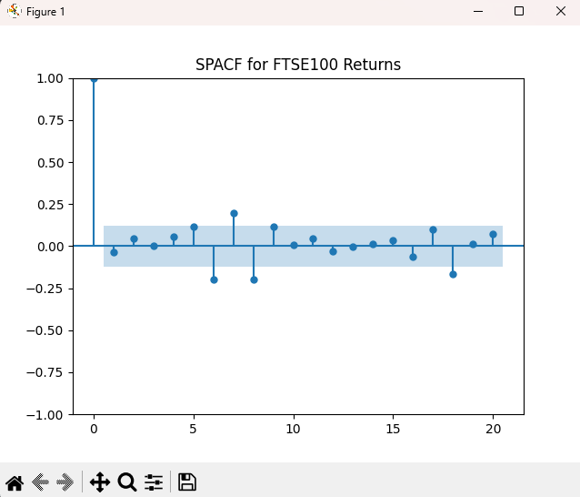
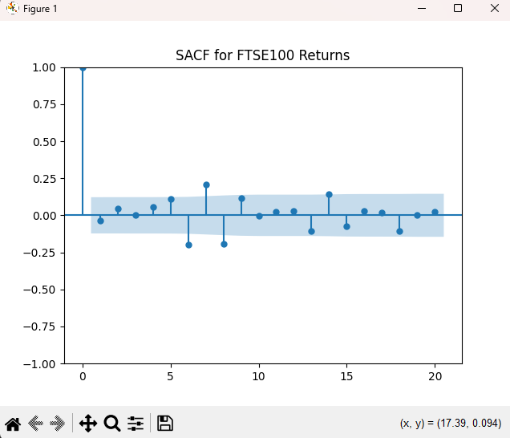
SACF and SPACF Analysis
SACF:
Significant lag-0 autocorrelation.
Indicates slight short-term dependencies in returns.
SPACF:
Confirms that only the first lag influences returns.
Supports efficient market hypothesis in the long term.

Slide 6
Unit Root Test
ADF Test Results:
FTSE100 Prices:
Statistic: − 0.7146872041680312, P-Value: 0.8429084540295886
Prices are non-stationary (random walk).
FTSE100 Returns:
Statistic: −16.52672186245335, P-Value: 2.04×10−292.04 \times 10^{-29}2.04×10−29
Returns are stationary (oscillate around a mean).

Slide 7
Co-integration Test
Results:
Statistic: −0.301342676988422
P-Value: 0.9758200433838476
Interpretation:
FTSE100 and S&P500 are no co-integrated.
Indicates long-term independence of the two indices, supporting diversification.

Slide 8
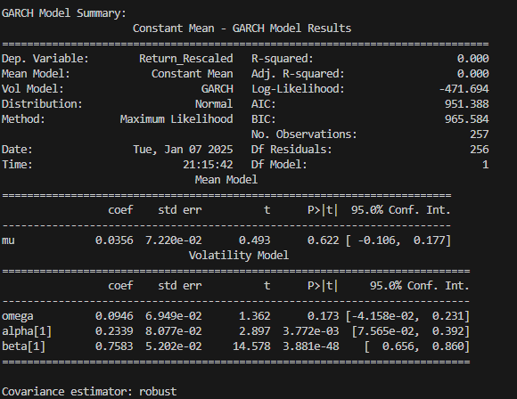
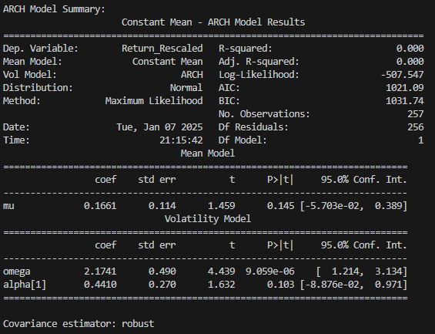
ARCH and GARCH Models
ARCH Model:
Alpha (ARCH): 0.4410, p-value 0.100
High volatility clustering.
GARCH Model:
Alpha: 0.2339, p-value 0.030 — Short-term shocks affect volatility.
Beta: 0.7583, p-value 0.000 — Strong long-term volatility persistence.

Slide 9
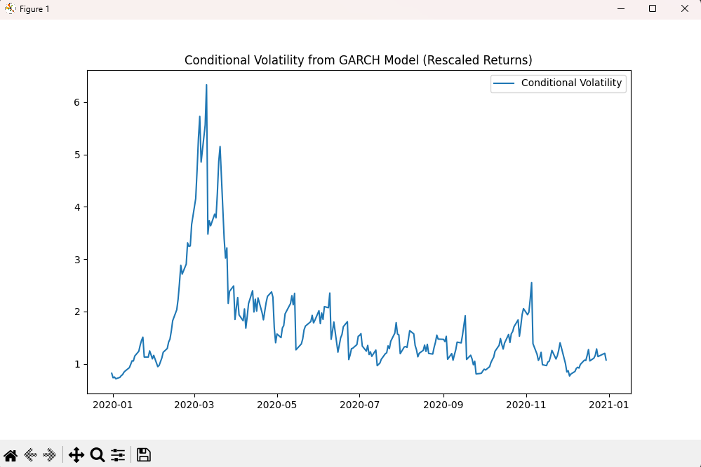
Conditional Volatility (GARCH)
Volatility Peaks:
Early 2020 corresponds to the COVID-19 pandemic.
Highlights heightened uncertainty during crises.
Stabilization:
Volatility declines post-2020, reflecting market recovery.

Slide 10
Thank You

